Slide 1

GREEN UNIVERSITY
computer science and engineering
Batch-193CSE- (DA)
Presented By
Presented To:
Babe Sultana
Lecturer
Dept. Of CSE
Green University of Bangladesh
Washeikh Al Abir 193002065
Sohrab Hossain Tosher 193002137
Rifat Talukdar 193002047
Tashfin Islam 193002021

Slide 2

Pages :
Home Page
About Page
Contract Page

Slide 3
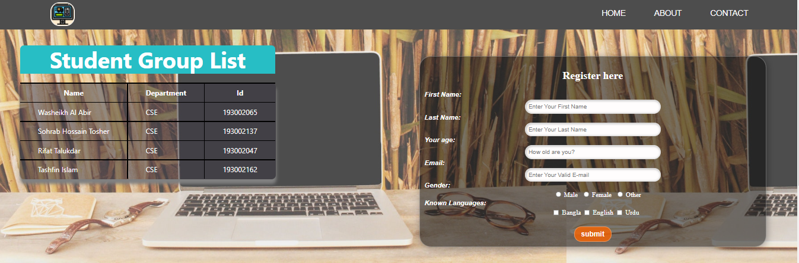
Home Page :

Slide 4
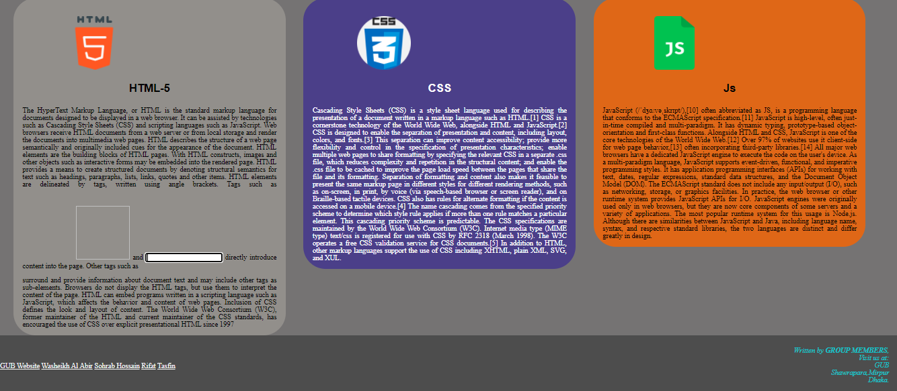
Home Page :

Slide 5
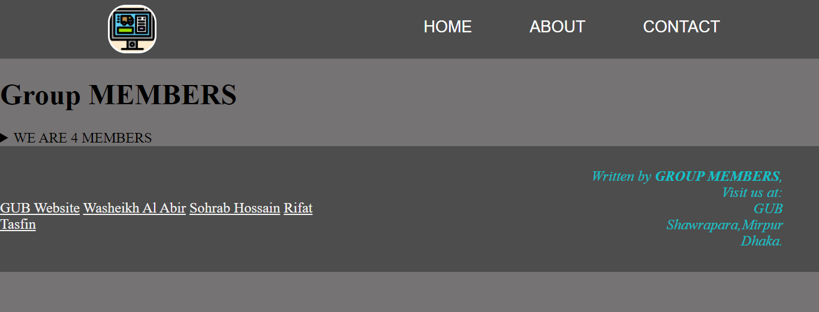
About Page :

Slide 6
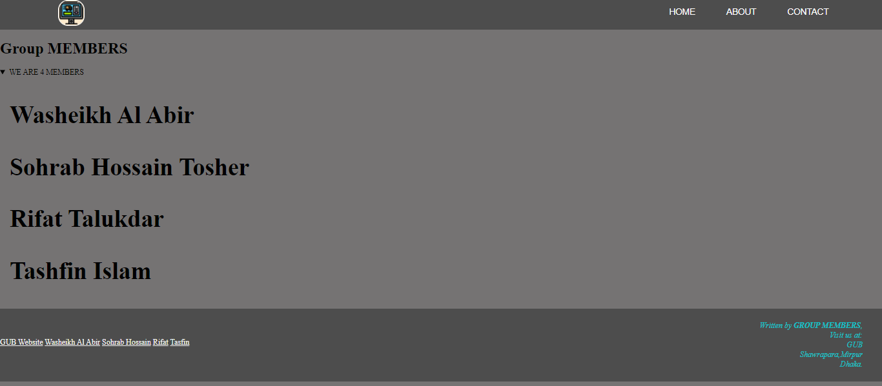
About Page :

Slide 7
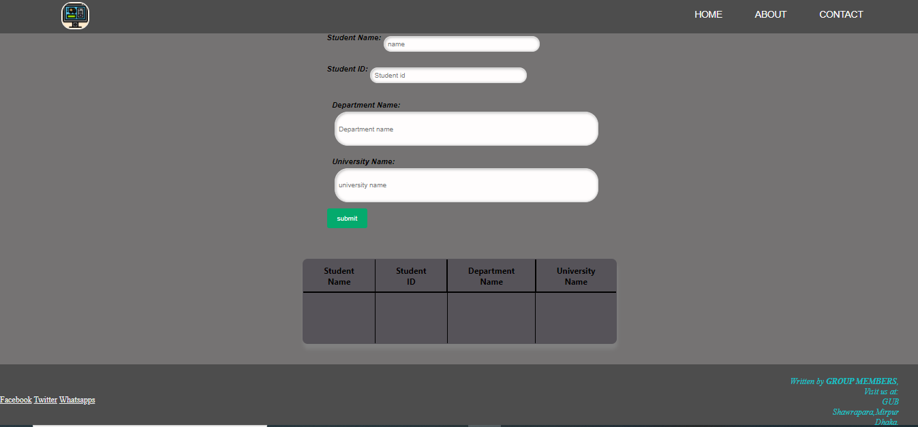
Contract Page :

Slide 8
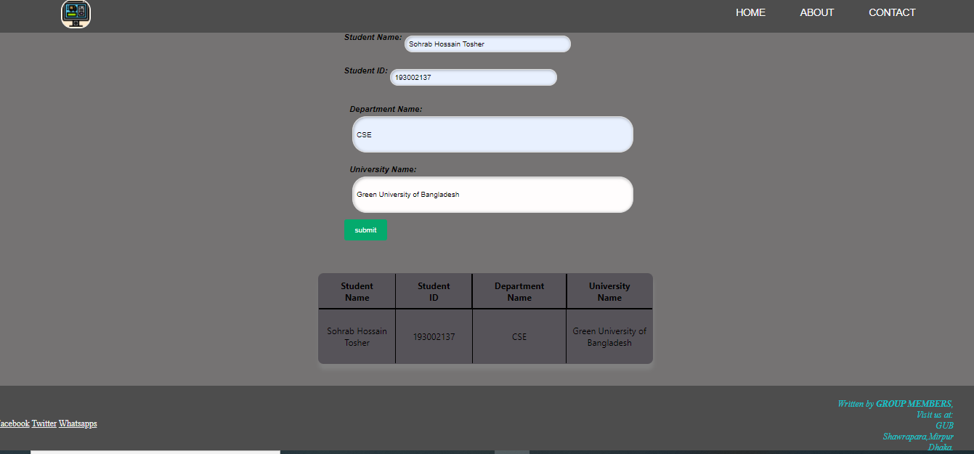
Contract Page :

Slide 9
THANK YOU MAM

